Slide 1

Cloud Scalability
Sathish Reddy Thadamla
700725818

Slide 2
Topics:
What is Scalability
What is Cloud Scalability
Why is Cloud Scalable
Types of Scalabilities
Difference between Vertical Scaling and Horizontal Scaling
Major Benefits of Cloud Scalability
When to use Cloud Scalability
References

Slide 3
Scalability:
Scalability is a term used to describe how the application will handle increased loads of traffic volume.
One of the most influential characteristics of cloud computing is its scalability.
Cloud Scalability:
Cloud scalability in cloud computing refers to the ability to increase or decrease IT resources as needed to meet changing demand. It’s the ability of a system to accommodate larger or smaller loads.
Businesses can scale up or down (vertically) and out or in (horizontally). For example, scaling up makes hardware stronger; scaling out adds additional nodes.

Slide 4
Types of Scalability
There are mainly three types of cloud scalabilities
Vertical Scaling
Horizontal Scaling
Diagonal Scaling

Slide 5
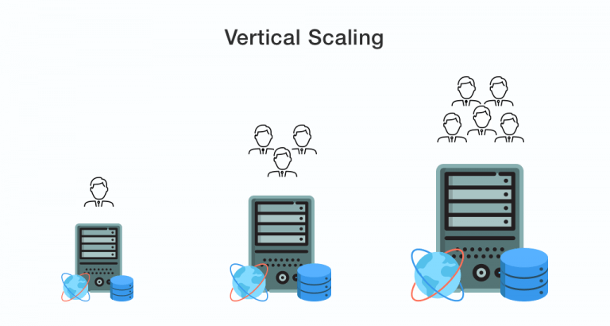
Vertical Scalability:
Vertical scalability is the ability to increase the capacity of existing Machine by adding resources.
Just resizing the capabilities of the working machine.
There is no need to alter the code .
It is also know as Scaling up.

Slide 6
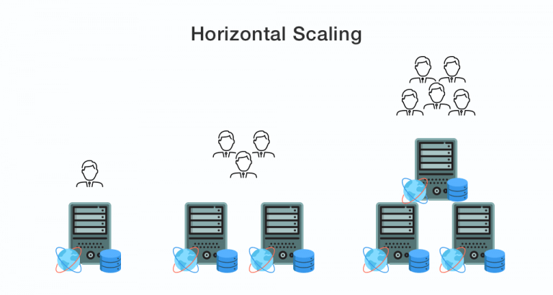
Horizontal Scalability:
Scaling works by incorporating additional nodes into the existing infrastructure.
The increased number of nodes helps to handle the increased workload rate.
It also Know as Scaling out.

Slide 7
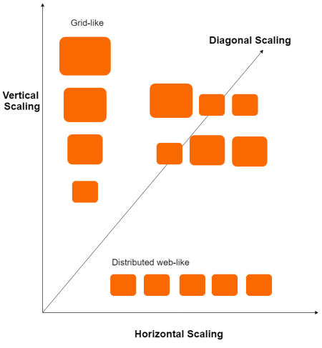
Diagonal Scalability:
It is the combination of both Vertical and Horizontal Scalability
By this mode we can get the flexibility of adding and removing of resources at a specific time instance.

Slide 8
Difference between Vertical and Horizontal Scaling:
In Horizontal Scaling we Breaking a sequential piece of logic into smaller parts so that it can be performed in parallel through several machines
In vertical scaling there is no need to alter the code .
Downtime
Concurrency
Message passing
Databases

Slide 9
Major Benefits of Cloud Scalability:
Cost-efficient : It reduce the cost of storge and the setting up of infrastructure unused by most of the time.
Performance: A scalable architecture can deal with sudden increase or decrease in traffic and perform accordingly
Fast and Flexible: By adding additional recourses there is no delay in the services once the payment is completed
Storage: Capable of taking care of your growth and data requirements.

Slide 10
When to use Cloud Scalability:
Scalability drives migration to the cloud. When a business grows and needs more resources, cloud scalability enables a rapid response. It also offers a cost-effective solution.
Conclusion:
Having said that, it’s important to think about how your business should scale, to get the optimal experience. Is horizontal scaling optimal or should you scale vertically. Is auto-scaling right for organization. Whatever, cloud computing scalability is important for a company.

Slide 11

Thank You

